Slide 1
Nourriture - Connect People with Ingredients
fastDev@Web Testing
Beijing Jiao Tong University

Slide 2
Test Automation
Beijing Jiao Tong University

Slide 3
Test Automation
What
Test Automation is the use of special software (separate from the software being tested) to control the execution of tests and the comparison of actual outcomes with predicted outcomes.
Why
Automate the repetitive but necessary tasks
Find the defects in the code, such as class, module or lib
Beijing Jiao Tong University

Slide 4
Types of Test Automation
Code (API) Driven Testing (Find the Defect)
To test method, class, module or lib, such as unit testing, integration testing, …
GUI Based Testing (Automate the Repetitive)
To test user interface or user behaviors/scenarios, such as system testing (GUI based testing), acceptance testing (GUI based testing), …
Beijing Jiao Tong University

Slide 5
What Unit Testing (a Testing Method)
Unit Testing is a software testing method by which individual units of source code, sets of one or more modules together with associated control data, usage procedures, … are tested to determine if they are fit for use
For instance, in OOP, a unit is often an entire class, but could be an individual method in it.
Substitutes such as method stubs, mock objects, fakes, and test harnesses can be used to assist testing a module in isolation.
Beijing Jiao Tong University

Slide 6
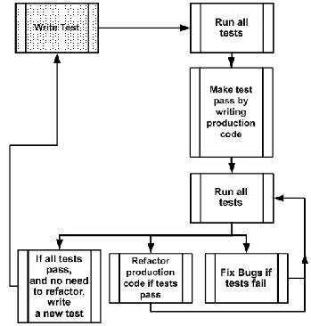
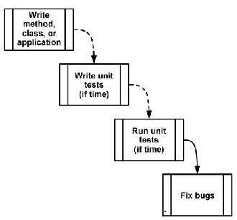
Why Unit Testing
Q: Why deliberately write a test we know is going to fail...? A: To get used to the idea of only writing the code required to pass the current (failing) test.
TDD
Beijing Jiao Tong University

Slide 7
What TDD
Test-driven development is a software development process that relies on the repetition of a very short development cycle
(spiral that write test->write code->refactor->write next test):
First the developer writes an (initially failing) automated test case that defines a desired improvement or new function, then produces the minimum amount of code to pass that test, and finally refactors the new code to acceptable standards.
The Nature of TDD that incremental
small steps lead to a quality end result
Beijing Jiao Tong University

Slide 8
What GUI Testing (a Testing Process)
Graphical User Interface testing is the process of testing a product's graphical user interface to ensure it meets its written specifications, or simulating the user behaviors (user event)
The Difficulty
Regression testing becomes a problem with GUIs, because a GUI may change significantly
Beijing Jiao Tong University

Slide 9
What Test Framework
Test Framework
Test Runner + Test Programming Interface + Test Oriented Lib
Run Test Case
Write Test Case
Assert, Reporting,...
Beijing Jiao Tong University

Slide 10
Unit Testing FWK
Mocha+Chai
Beijing Jiao Tong University

Slide 11
What Mocha+Chai
Mocha is a JavaScript test framework running on node.js and the browser, making asynchronous testing simple.
Chai is a BDD / TDD assertion library for node.js and the browser that can be paired with any javascript testing framework.
Beijing Jiao Tong University

Slide 12
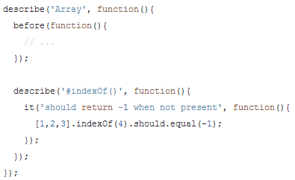
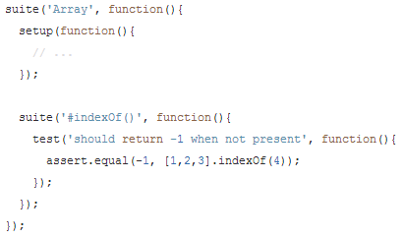
Mocha Test Framework
BDD
Expressive
TDD
Classical
Beijing Jiao Tong University

Slide 13
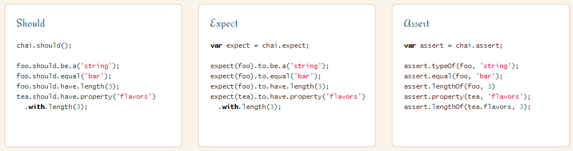
Chai Assertion Library
BDD
Expressive
BDD (upon Should)
Expressive
TDD
Classical
Beijing Jiao Tong University

Slide 14
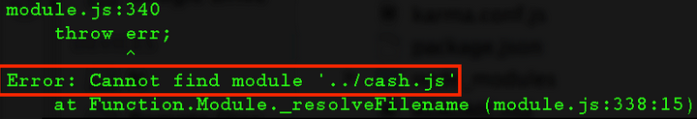
How TDD spiral that write test->write code->refactor->write next test
touch test.js
var C = require(‘./cash.js');
mocha
touch cash.js
Write Test
Write Code
Refer to full example https://github.com/nelsonic/learn-mocha
Beijing Jiao Tong University

Slide 15
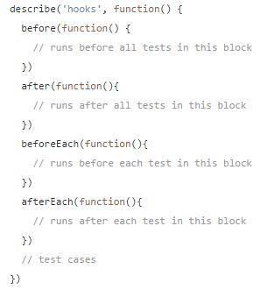
Mocha Hooks
Mocha provides the hooks as below, that can be used to set up preconditions and clean up your tests.
before(), after(), beforeEach() and afterEach()
Making it easier to pinpoint errors, we could give a name to hooks if no description is supplied.
Beijing Jiao Tong University

Slide 16
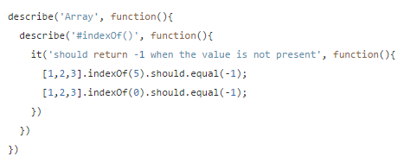
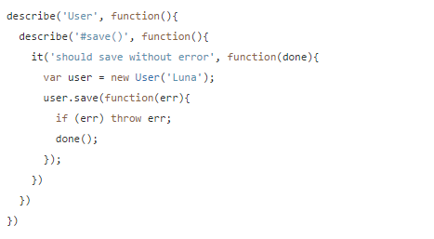
Sync vs. Async
Sync
Async
By adding a callback (usually named done) to it() to notify Mocha to wait for the completion
Beijing Jiao Tong University

Slide 17
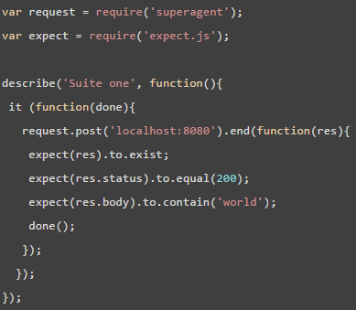
Test Node.js
SuperAgent is a small progressive
client-side HTTP request library
BDD style
The test name
The test case
Async completion
Beijing Jiao Tong University

Slide 18
GUI Testing FWK
WebDriver
Beijing Jiao Tong University

Slide 19
What W3C WebDriver
W3C WebDriver Spec
This specification defines the WebDriver API, a platform and language-neutral interface that allows programs or scripts to introspect into, and control the behavior of, a web browser.
The WebDriver API is defined by a set of interfaces to discover and manipulate DOM elements on a page, and to control the behavior of the containing browser.
W3C WebDriver is strongly based on an existing Open Source project —Selenium WebDriver
Beijing Jiao Tong University

Slide 20
What Selenium WebDriver
Selenium automates browsers. That's it!
The biggest change in Selenium recently has been the inclusion of the WebDriver API, which fits in the same role as RC did to incorporate the original 1.x bindings.
Selenium 1.0 + WebDriver = Selenium 2.0
Binding + API = Selenium WebDriver
Driving a browser natively as a user would either on a local machine or on a remote machine (using the Selenium Grid)
Beijing Jiao Tong University

Slide 21
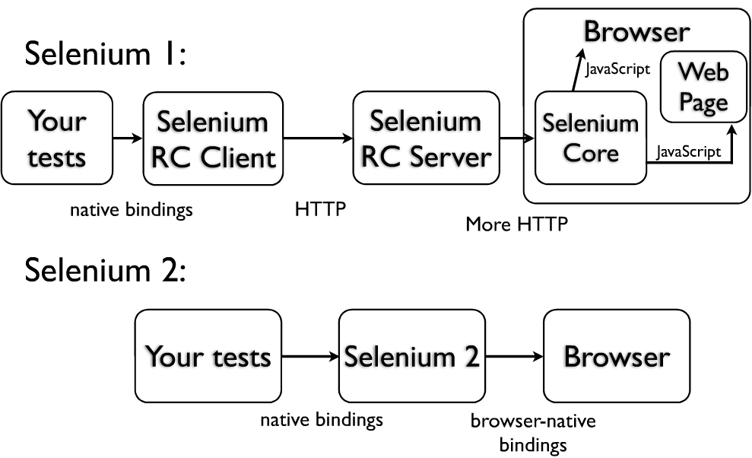
Selenium 1 vs. Selenium 2
Inject JavaScript into the browser and communicate with browser via that
The WebDriver code uses the native API (native binding) for each browser
Beijing Jiao Tong University

Slide 22
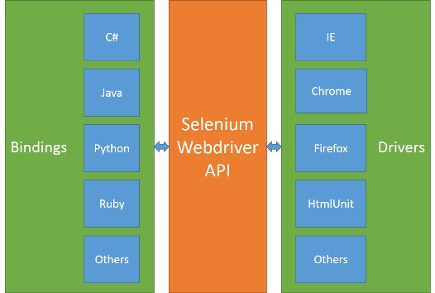
Native Binding (API in Browser)
Beijing Jiao Tong University

Slide 23
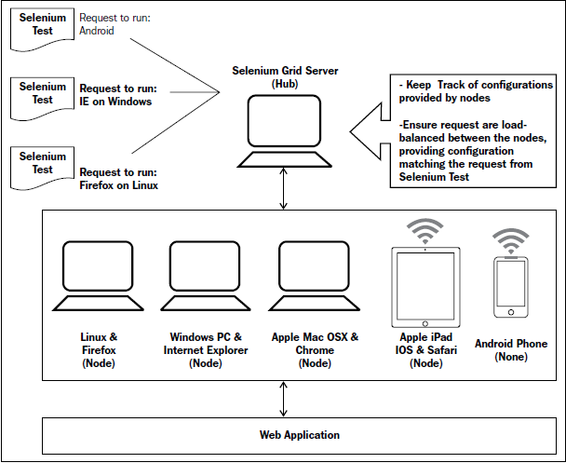
What Selenium Grid
It allows you run the tests on different machines against different browsers in parallel; in other words it enables distributed test execution.
Beijing Jiao Tong University

Slide 24
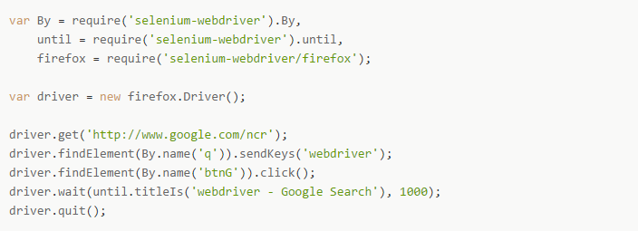
How it Works
Beijing Jiao Tong University

Slide 25
Best Practice @Location Strategy
CSS Selectors (if possible)
ECMAScript (JavaScript class)
Element ID
Link Text
Partial Link Text
Xpath (if no choice)
Beijing Jiao Tong University

Slide 26
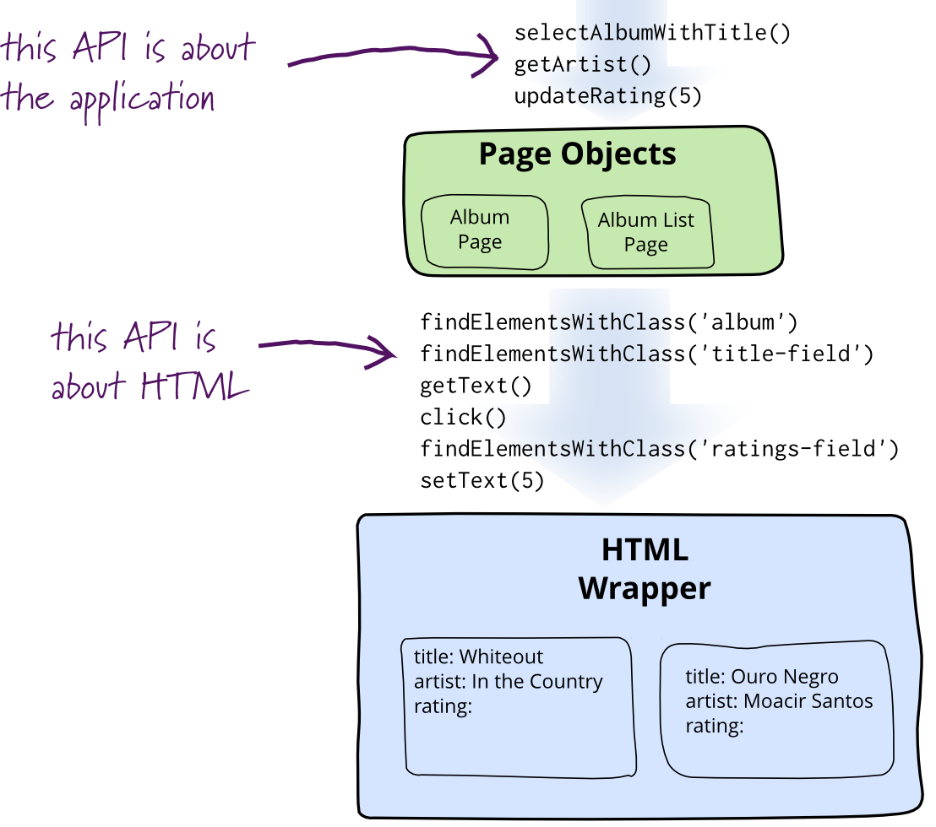
Best Practice @Page Object Design Pattern
A Page Object simply models the user interaction with user interface in the page as objects within the test code.
tests/[appname].js //page object
tests/[appname]_test.js //test code
Beijing Jiao Tong University

Slide 27
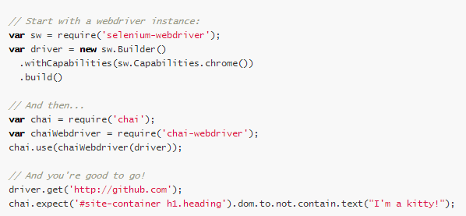
Chai plugins @ chai-webdriver
Expressive in BDD style
Beijing Jiao Tong University

Slide 28
Reference
https://github.com/nelsonic/learn-mocha
http://chaijs.com/
http://mochajs.org/
https://github.com/shouldjs/should.js
http://webapplog.com/test-driven-development-in-node-js-with-mocha/
http://code.tutsplus.com/tutorials/testing-in-nodejs--net-35018
https://www.npmjs.org/package/selenium-webdriver
http://chaijs.com/plugins/chai-webdriver
http://artofunittesting.com/storage/chapters/SampleChapter1.htm
Beijing Jiao Tong University

